Slide 1
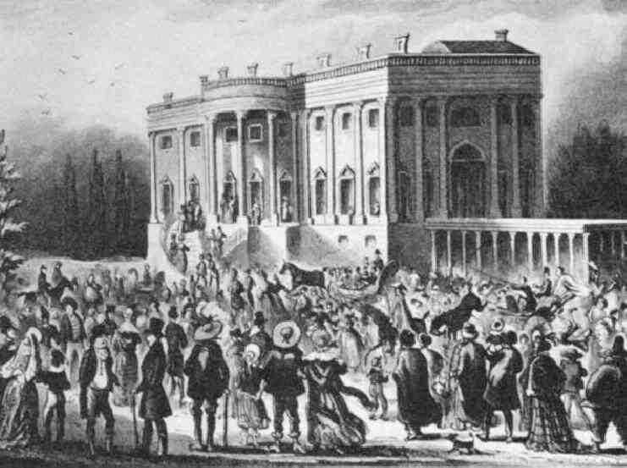

DEMOCRACY IN THE AMERICAN REPUBLIC
History 180 - 5
Notes:
Songs: “Hunters of Kentucky” (Andrew Jackson’s campaign song) and “Little Know Ye Who’s Coming” (John Quincy Adam’s campaign theme song)

Slide 2
BIG QUESTIONS OF THE DAY
1) How did the immediate challenges following the American Revolution help shape the Constitution of the United States?
2) In what ways did the Jacksonian Era (the presidency of Andrew Jackson) serve to expand involvement in the American republic? In what ways did the republic continue to limit inclusion?

Slide 3
A REVOLUTION IN THOUGHT, NOT JUST POLITICS
republicanism – from Latin res publica, the public thing
Some elements of republicanism:
Complete rejection of monarchy (monarchy = tyranny)
Rejection of most hierarchical authority
Public virtue is the center of political life
Government power leads to tyranny and oppression (governments should govern as little as possible)
Sovereignty flows upward from the people, not down from a leader (Need consent of the governed)

Slide 4
WHO CONSTITUTES THE PEOPLE?
Those without property?
Women?
Native Americans?
African Americans?

Slide 5
ARTICLES OF CONFEDERATION
Question: Strong government or loose?
Powers of Congress:
1. Regulate foreign affairs
2. Declare war
3. Mediate boundaries between states
4. Manage a national Post Office
5. Sign treaties with Indians
Also, national citizenship (not state)
Limited power to Tax (power resides in the states)

Slide 6
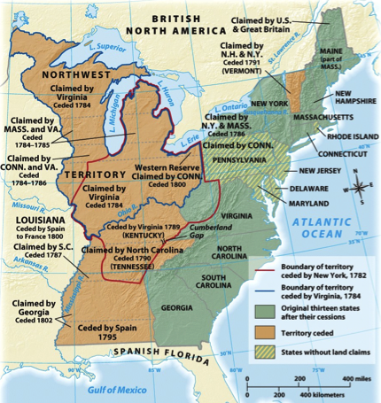
PROBLEMS OF THE WESTERN LANDS

Slide 7
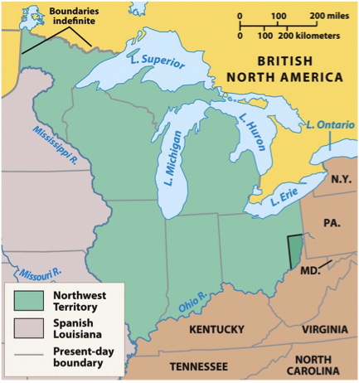
The Northwest Ordinance of 1787
Established a pattern for the creation of new states.
One of the great successes of the Confederation government.

Slide 8
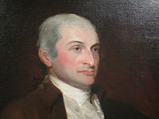
FOREIGN POLICY CHALLENGES
British forts in the NW territory
Forts Detroit, Michilimackinanc, Niagara
Native Americans
Treaty of Fort Stanwix
Spanish control of New Orleans
John Jay

Slide 9
DOMESTIC CHALLENGES
National Debt
Loss of Trade
Issue of Taxation

Slide 10
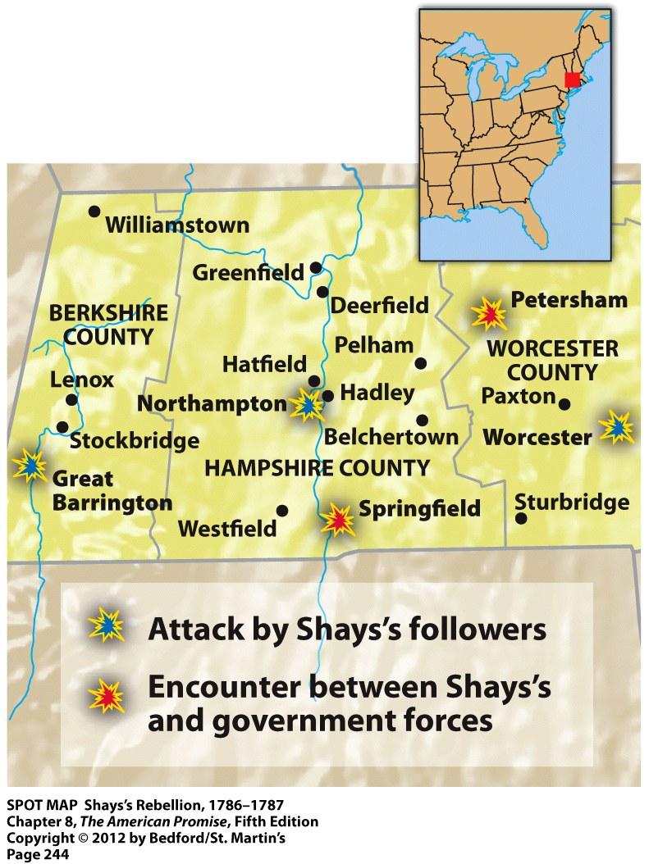
SHAYS’ REBELLION
Shays’ Rebellion raised the prospect of a new type of tyranny – tyranny by the mob.
4 killed, 20 wounded in battle in January 1787.
Final battle is bloodless.
Q: Is too much democracy a bad thing?

Slide 11
THE CONSTITUTIONAL CONVENTION
55 delegates met from May-September 1787 in “Independence Hall” in Philadelphia
Attendees:
Ben Franklin, John Jay, Alexander Hamilton, James Madison, George Washington
Two plans:
Virginia Plan:
strong nat’l gov’t
Bicameral congress
National judiciary
New Jersey Plan
Strengthen the Articles of Confederation by giving Congress the power to tax interstate commerce

Slide 12
THE GREAT COMPROMISE – JULY 12, 1787
Lower house of congress (House of Representatives)
Directly Elected
Proportional representation
Includes white population but 3/5 of the Black population
2-year term
Upper house of Congress (Senate)
Elected by state legislatures
Same representation for large and small states
2 representatives each
6 year term

Slide 13
FEDERALISTS AND ANTI-FEDERALISTS
Federalists
Desire to render the government of the country adequate to the job
Distrust of “the mob”
Representative government
Anti-Federalists
Liberty exists in state legislatures, close to the people
Distrust of government
Ideal of democracy

Slide 14
THE CONSTITUTION AND REPRESENTATIVE DEMOCRACY
1. President elected by electors
2. Senators named by state legislatures
3. Slave trade ends after 20 years
4. Congress has power to collect taxes and regulate commerce
5. “The Elastic Clause”
6. Nine states must ratify to have Const. go into effect
7. Federal power supreme over state law

Slide 15
CHECKS AND BALANCES
Three branches of government
Executive
Legislative (bicameral)
1. Senate
2. House of Representatives
Judiciary
Amendment process

Slide 16
BILL OF RIGHTS
1. Freedom of religion, speech, press, assembly, and petition.
2. Right to keep and bear arms in order to maintain a well regulated militia.
3. No quartering of soldiers.
4. Freedom from unreasonable searches and seizures.
5. Right to due process of law, freedom from self-incrimination, double jeopardy.
6. Rights of accused persons, e.g., right to a speedy and public trial.
7. Right of trial by jury in civil cases.
8. Freedom from excessive bail, cruel and unusual punishments.
9. Other rights of the people.
10. Powers reserved to the states.

Slide 17
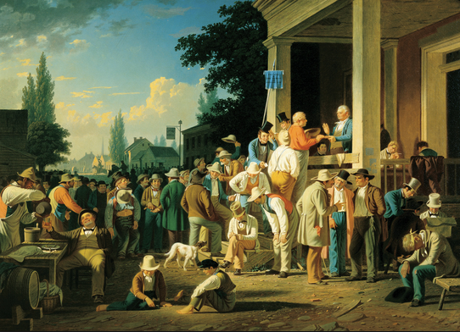
THE “ERA OF THE COMMON MAN”
The Hunters of Kentucky https://www.youtube.com/watch?v=eOUvw9dyNxE
Little Know Ye Who’s Comin’ https://www.youtube.com/watch?v=TeCmtKxYfzA

Slide 18
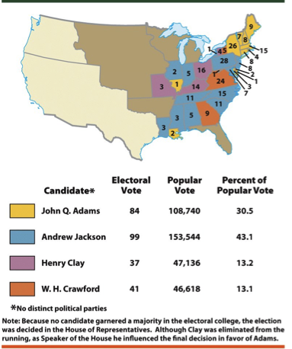
THE ELECTION OF 1824

Slide 19
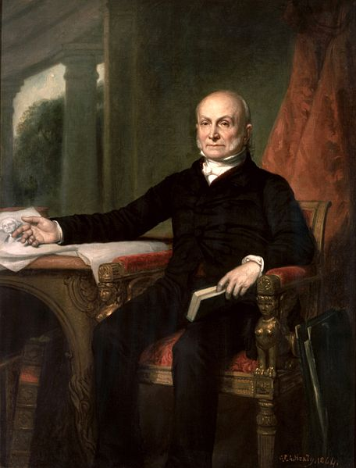
PRESIDENCY OF JOHN QUINCY ADAMS
One-term president, leader of the “National Republicans”
Bookish, and aloof as partisan politics changed around him
1856 portrait of President Adams

Slide 20
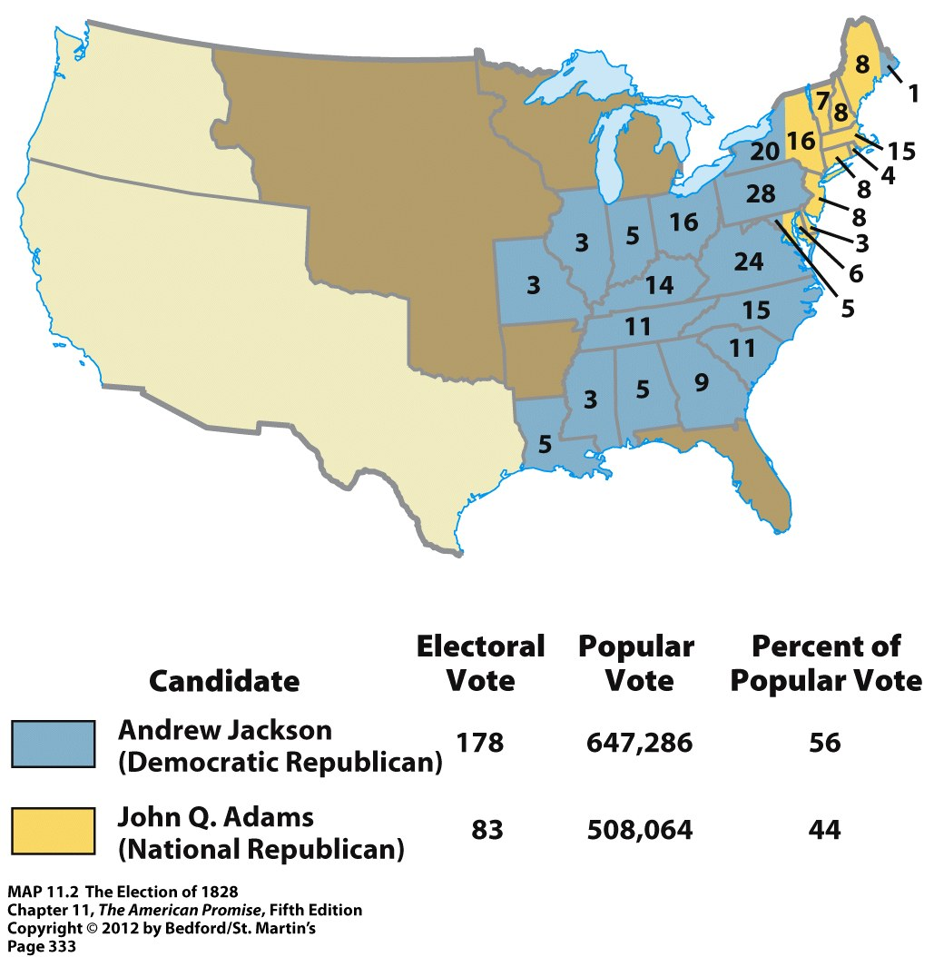
ELECTION OF 1828
Popular participation
New campaign styles
If the popular vote matters, how will political campaigns change?
New political parties

Slide 21
THE REIGN OF KING MOB

Slide 22
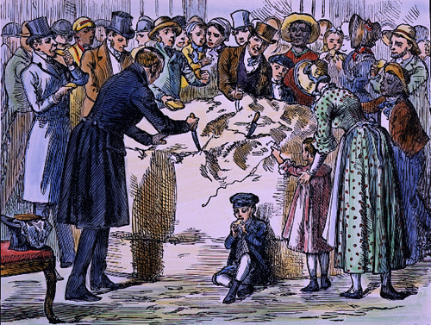
President Jackson shares a 1,400 pound wheel of cheese with the people
of the United States, demonstrating his populist touch.

Slide 23
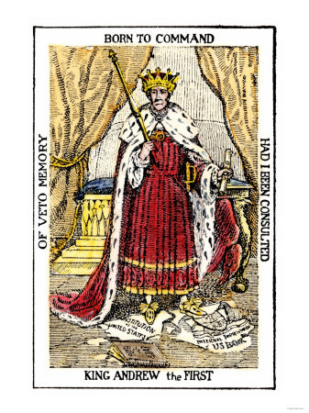
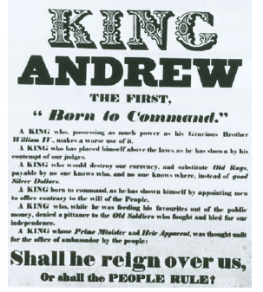

Slide 24
PERSISTENT EXCLUSION
Included:
White men who owned property
White men without property who could support themselves financially
Excluded:
Paupers and felons
Women regardless of status
African Americans
Property requirements often kept for African Americans

Slide 25
NEXT TIME:
“Social Histories of Antebellum America ”
Required reading:
Roark chapter 10 (303-309), Roark chapter 11 (319-320), Chapter 12 (339-342, 358-362), Chapter 13 (all)

Slide 26
TERMS TO REVIEW
Articles of Confederation
Northwest Ordinance
Shays’ Rebellion
Constitutional Convention
Antifederalists
Federalists
The U.S. Bill of Rights
minority rights
Marquis de Lafayette
John Quincy Adams
Andrew Jackson
“King Andrew I”

Slide 27
BROAD QUESTIONS TO REVIEW
What factors accounted for the ability of the American “patriots” to win the Revolutionary War?
Why did the framers of the U.S. Constitution fear that the Articles of Confederation had allowed for too much democracy? In what ways could the Constitution be seen as a conservative document after the turmoil of the American Revolution? In what ways were its use of federal power unprecedented?

Slide 28
LIBERTY: THE AMERICAN REVOLUTION, EP. 6 ARE WE TO BE A NATION
What were the major issues afflicting the newly independent American states after 1783? In what ways did the framing of the U.S. Constitution serve to address some of those issues?
Terms:
Loyalists
deference
John Adams
Alexander Hamilton
Noah Webster’s speller
currency
taxation authority
Shay’s Rebellion
Constitutional Convention
James Madison
minority rights
Antifederalists
Bill of Rights
slavery

